Slide 1
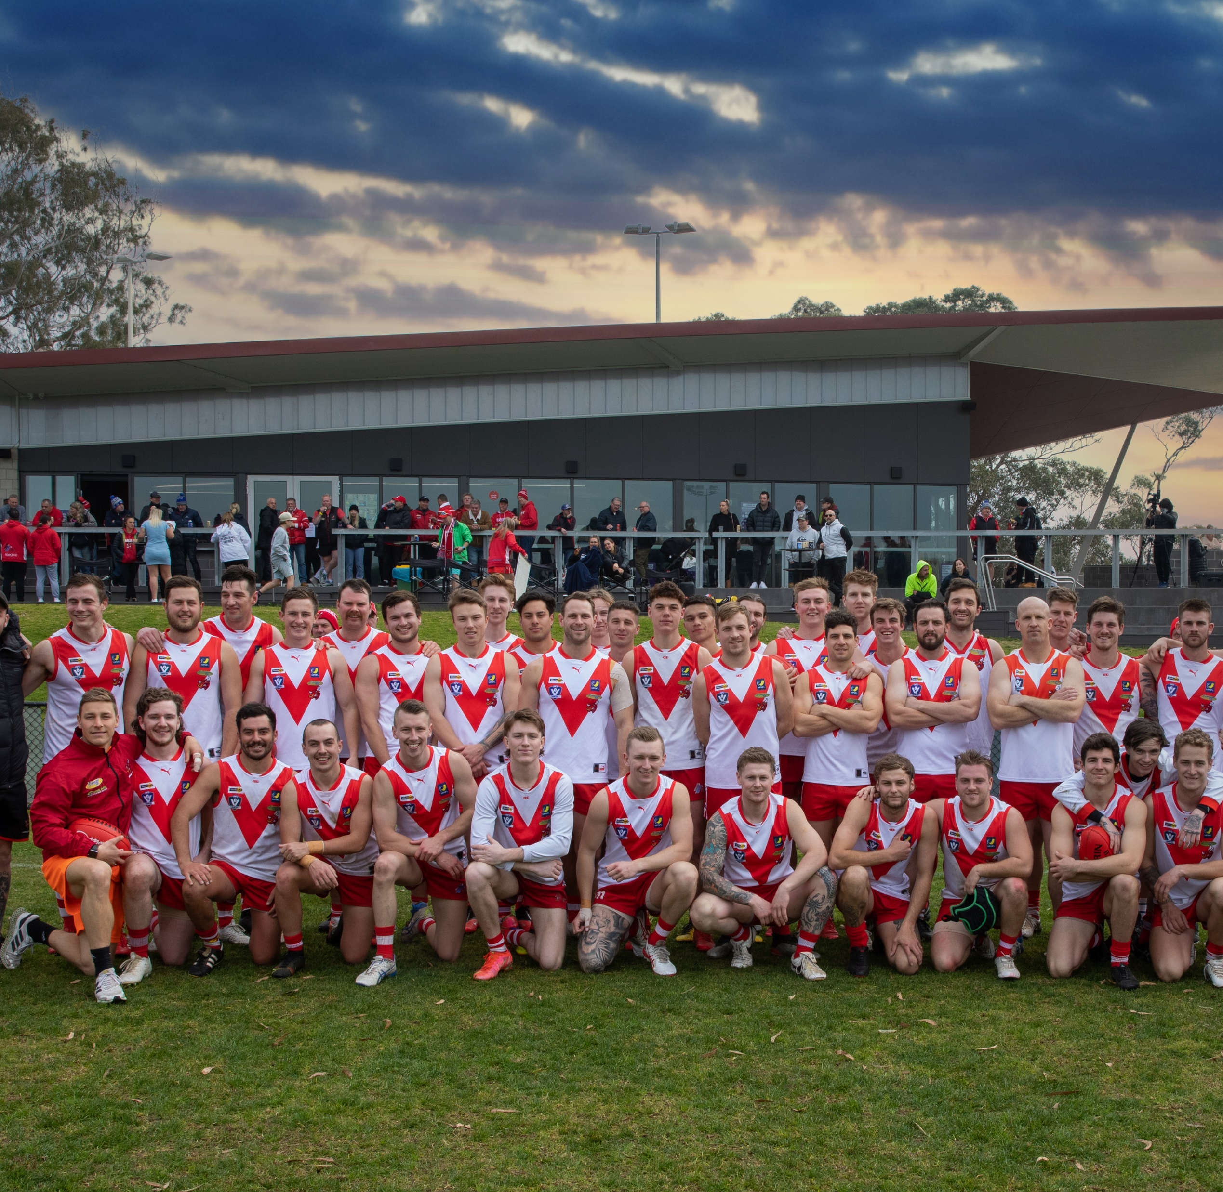

Karingal F.N.C. 2022
Join the Bulls stampede in 2022.

Slide 2
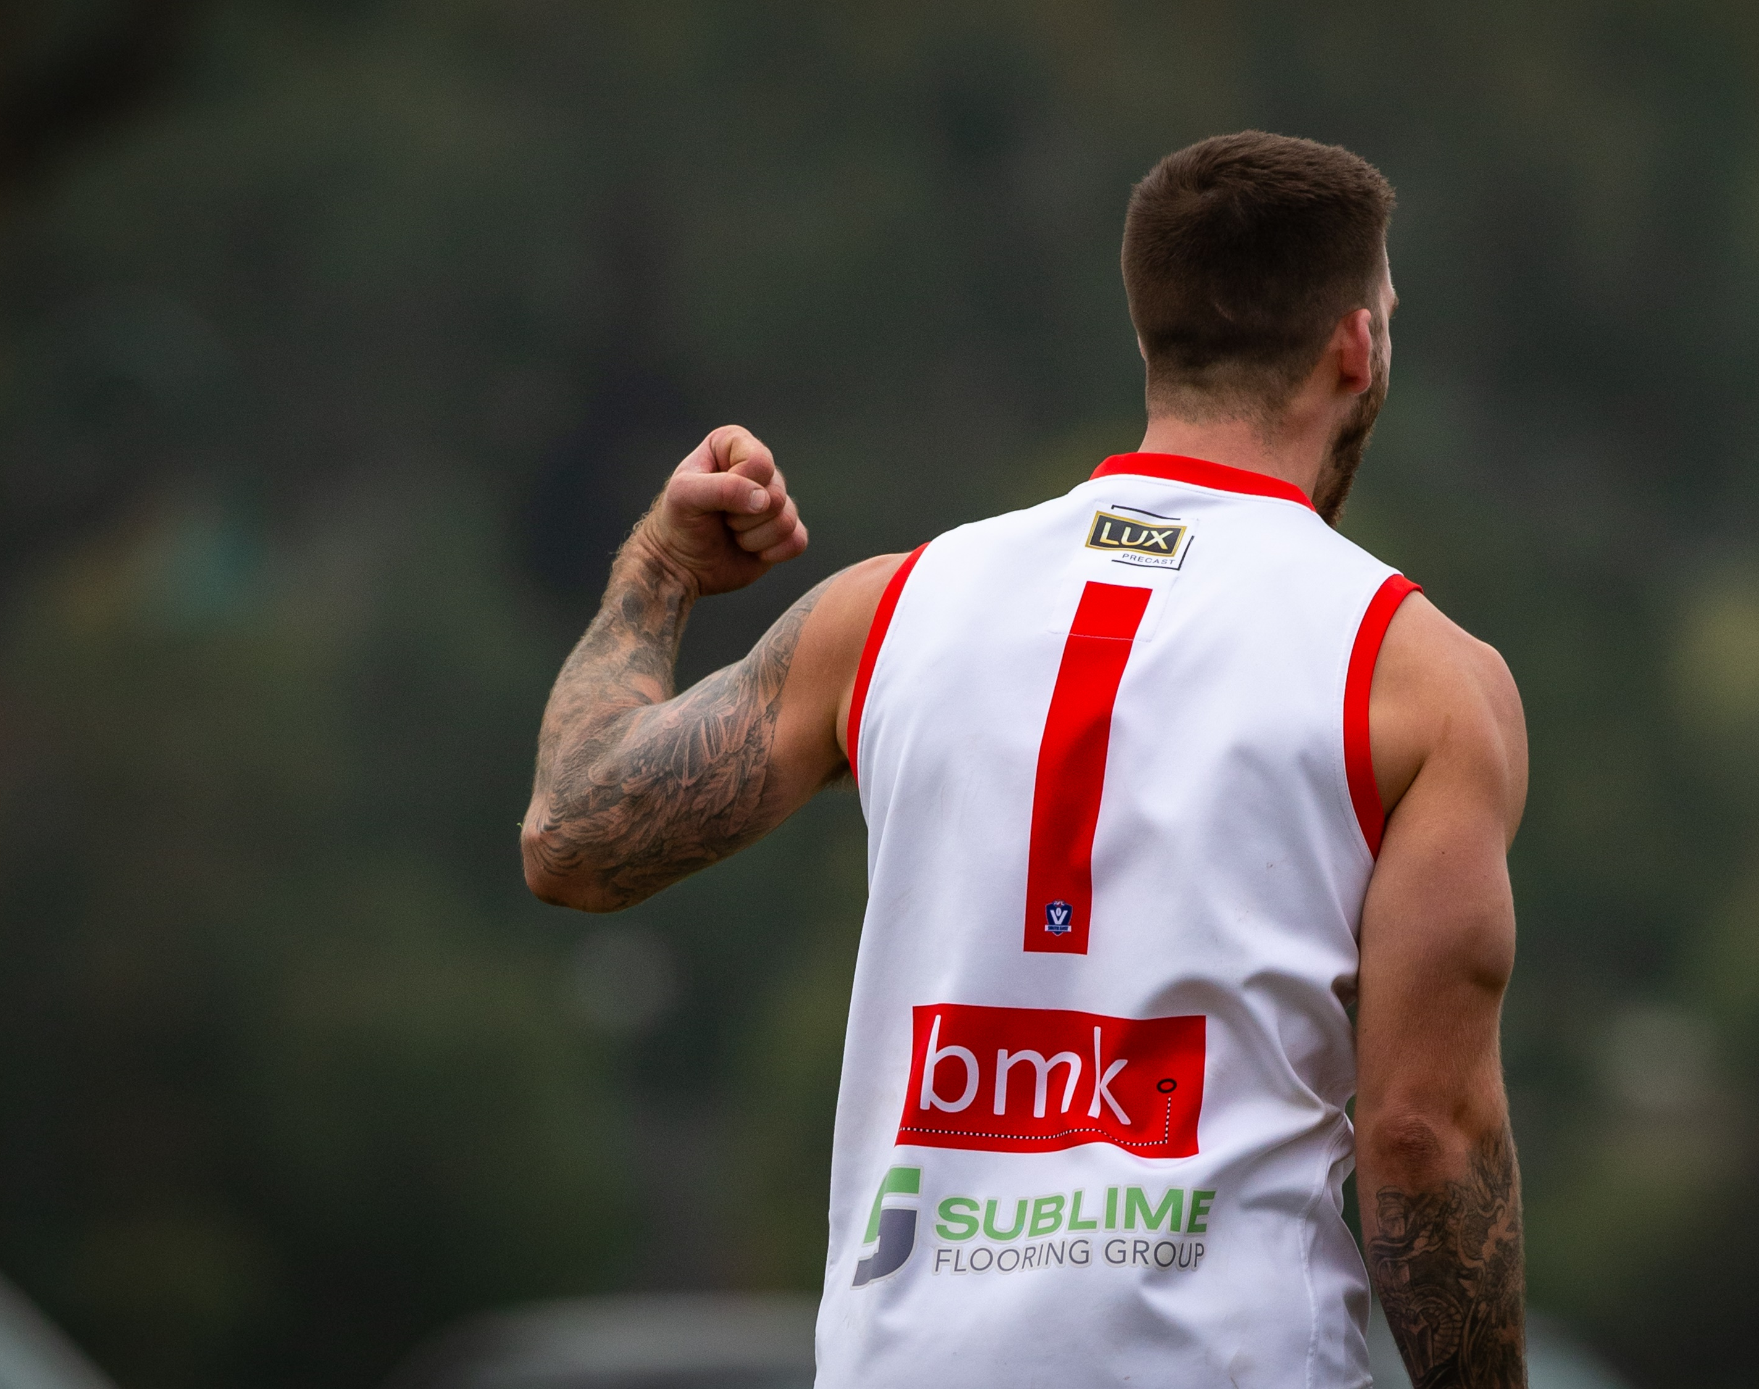
Our club aims to be the Number one community Football Netball Club on the Peninsular; we need your assistance to achieve our goals.
Karingal Football Netball Club was established in 1969, we are a proud and successful club.
We compete in the Nepean Football League (MPNFL) with over 40 years of passionate and committed Karingal people have given to the club and make it their own. We need people from our local community to keep getting involved to make sure, our club stays strong and provides a strong local community presence.

Slide 3
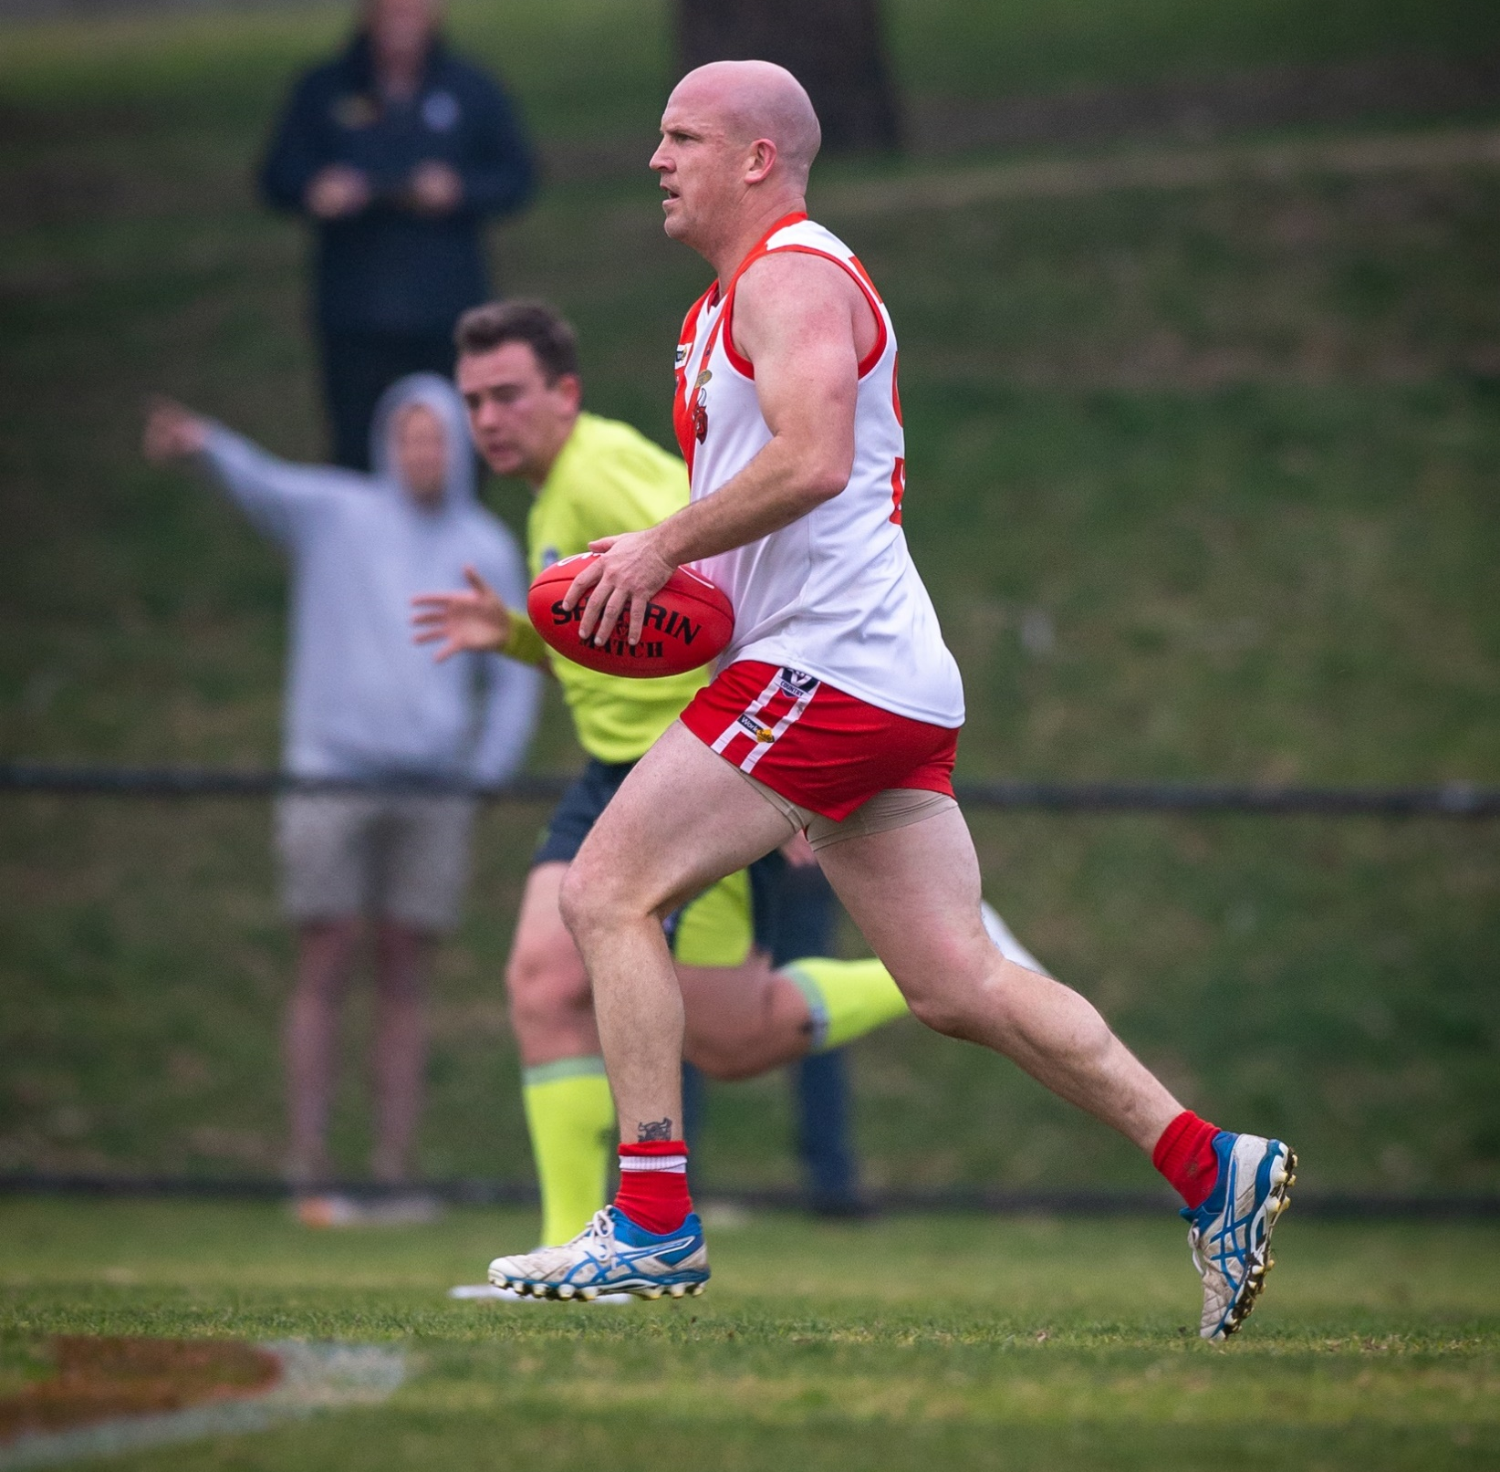
Mission Statement
Karingal Bulls are dedicated to creating a strong community presence by providing a friendly and welcoming environment, state of the art facilities and a commitment to our community to always deliver the very best performances both on and off the field.
We respect the rights, dignity and worth of all players, teammates & opposition, and expect good sportsmanship from everybody attending a match or at training.

Slide 4
Club Overview
4 Senior football teams, Seniors, Reserves, Under 19’s & Senior Woman's Team
5 Netball Teams, A Grade, B Grade, C Grade, D Grade & under 17’s team.
200+ Club Members – Including Club 44 & The Red & White Army Coterie Groups
1996 & 1999 Senior Premierships, 2018 Reserve & Under 19 Premiers. Netball - 2018 A Grade Premierships
13 Junior Teams both boys and Girls teams from under 9’s to under 16’s
Auskick – 100 + Participants in 2021
Social Media – Facebook, Instagram, Twitter, connecting with over 5000 users.
Website – www.karingalfc.com

Slide 5
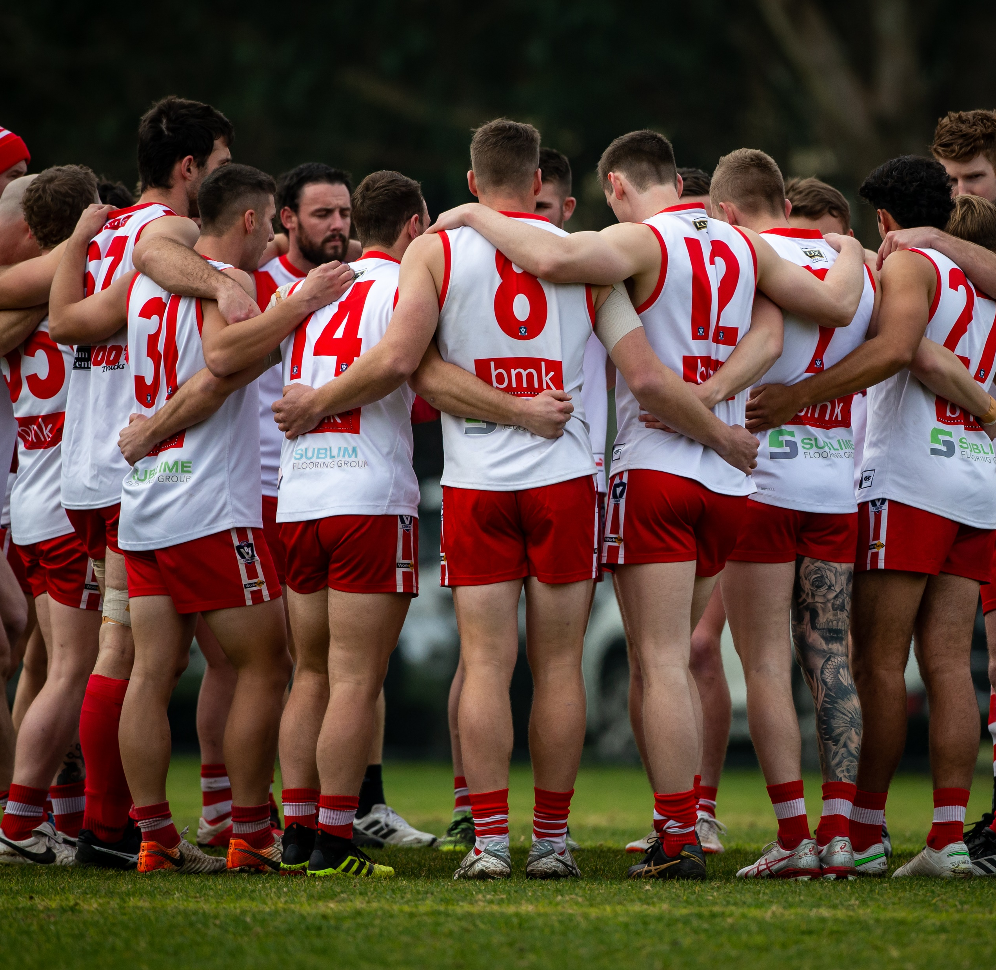
Community.
The Karingal Football Netball Club takes its responsibility to our local community seriously. We have a proud history of giving back to our community through events such as Clean up Australia day, involvement with Zaidee’s foundation, participation in Call to Arms cancer campaign plus many others.
In 2022 we will strengthen this bond even further with activities such as.
The Anzac Day Dawn service supporting the Frankston RSL Welfare Association.
Continued relationship with Game Changer supporting Mental Health.
All the above will be promoted and advertised through Karingal’s extensive network, including all social media outlets and on our website.

Slide 6
Sponsorship opportunities.
Why Sponsor?
Our goal is to provide all of our sponsors with an opportunity to increase your company Brand and business via our many social medial outlets and ground advertising.
We will also be able to network your business with our other sponsorship partners at all of our home games.
Strengthen your band by being associated with a strong leading community club on the Peninsular who attracts families to our games from Hastings, Chelsea, Mornington, Rye and Seaford, the coverage and milage your brand will receive will be beneficial to your business.
All sponsorship attracts a taxable right off and our club has acquired the services of a tax consultant who can assist you prior to you selecting which package best suits your business and cash flow.
The most important reason for sponsorship to our club is the benefits it brings to make our club stay at the forefront and continue to be able to supply the very best facilities so we can involve our local community in our great club, and to provide all our players with the very best opportunity to play our great sports and learn for our highly qualified coaching staff.

Slide 7

Sponsorship packages.
Platinum Membership
$15,000
Exclusive use of the title, “ Proud Sponsor of The Karingal FNC “ For the 2022 season.
Naming rights to one home game the first 9 sponsors will receive a game day run through banner to promote their business.
4 Fence ground signs, 1 placed at the front of the clubrooms for maximum exposure, 3 others to be placed around the ground.
300 A5 Single sided flyers to be displayed in our club rooms on your selected game day.
Your company logo on display on all our social pages, Facebook, Instagram, twitter and onto our web site.
Your logo will also be placed inside our club rooms on our TV digital display throughout home games.
Complimentary tickets (6) to our Presidents Luncheon, where you will be introduced to our guests.
Club 44 Membership card for the 2022 season.
Entry into the players rooms for 2 games for the coach's pregame address. ( to be booked in prior to round 1)
Welcome pack including 6 membership tickets.
Your company logo onto our club Polo shirt sleeve.
Framed A3 Sponsor Certificate

Slide 8
Sponsorship packages.
Gold Membership
$10,000
Exclusive use of the title, “ Proud Sponsor of The Karingal FNC “ For the 2022 season.
Ground Signage, 2 Fence ground signs, 1 placed at the front of the clubrooms for maximum exposure, 1 others to be placed around the ground.
Your company logo on display on all our social pages, Facebook, Instagram, twitter and onto our web site.
Your logo will also be placed inside our club rooms on our TV digital display throughout home games.
Complimentary tickets (4) to our Presidents Luncheon, where you will be introduced to our guests.
Club 44 Membership card for the 2022 season.
Welcome pack including 4 membership tickets.
Framed A3 Sponsor Certificate
Your company logo onto our club Polo shirt sleeve.

Slide 9
Sponsorship packages.
Silver Membership
$5,000
Exclusive use of the title, “ Proud Sponsor of The Karingal FNC “ For the 2022 season.
Ground Signage, 1 fence signage to be placed at the ground.
Your company logo on display on all our social pages, Facebook, Instagram, twitter and onto our web site.
Your logo will also be placed inside our club rooms on our TV digital display throughout home games.
Complimentary tickets (2) to our Presidents Luncheon, where you will be introduced to our guests.
Club 44 Membership card for the 2022 season.
Welcome pack including 2 membership tickets.
Framed A3 Sponsor Certificate

Slide 10
Sponsorship packages.
Bronze Membership
$2,000
Exclusive use of the title, “ Proud Sponsor of The Karingal FNC “ For the 2022 season.
Ground Signage, 1 fence signage to be placed at the ground.
Your company logo on display on all our social pages, Facebook, Instagram, twitter and onto our web site.
Your logo will also be placed inside our club rooms on our TV digital display throughout home games.
Welcome pack including a club membership tickets.
Framed A3 Sponsor Certificate

Slide 11
Sponsorship packages.
Club Membership
$1,000
Exclusive use of the title, “ Proud Sponsor of The Karingal FNC “ For the 2022 season.
Ground Signage, 1 fence signage to be placed at the ground.
Your logo will also be placed inside our club rooms on our TV digital display throughout home games.
Welcome pack including a club membership ticket.
Framed A3 Sponsor Certificate

Slide 12
Sponsorship packages.
¼ time and ¾ time Huddle signage. Membership
$3,000
Exclusive use of the title, “ Proud Sponsor of The Karingal FNC “ For the 2022 season.
Ground Signage with your company logo displayed in front of the senior teams coaches address at ¼ time and ¾ time breaks
Your logo will also be placed inside our club rooms on our TV digital display throughout home games.
Welcome pack including a club membership ticket.
Framed A3 Sponsor Certificate

Slide 13
Sponsorship packages.
Stubby Holder sponsor Membership
$3,000
Exclusive use of the title, “ Proud Sponsor of The Karingal FNC “ For the 2022 season.
Ground Signage 1 fence signage displayed at the ground
Your logo will also be placed inside our club rooms on our TV digital display throughout home games.
Your company logo will be exclusive to our club stubby holders for the 2022 season
Welcome pack including a club membership ticket.
Framed A3 Sponsor Certificate

Slide 14
Sponsorship packages.
Club 44 Membership
$500.00
Club 44 Membership for season 2022
Entry into Club rooms from ½ time reserves to ½ time seniors at fixtured home games
Finger food , Beer, wine, soft drink included from 12 – 2pm at fixtured home games
Spirits available at club prices.
1 club 44 cap
1 Club 44 membership ticket for 2022 season

Slide 15
Sponsorship packages.
Red & White Army, Early Bird Membership
$70.00 Entry into all home games valid until round 1 2022
.

Slide 16
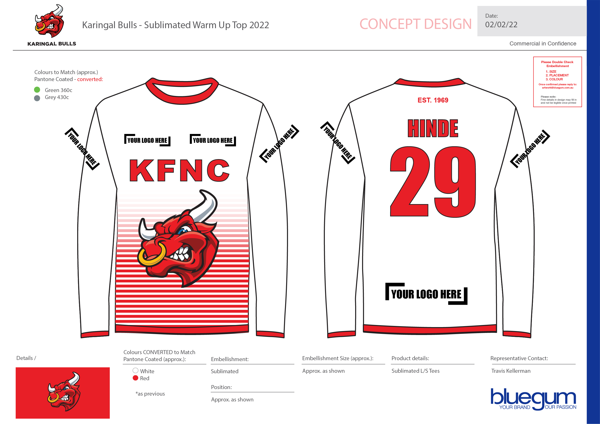
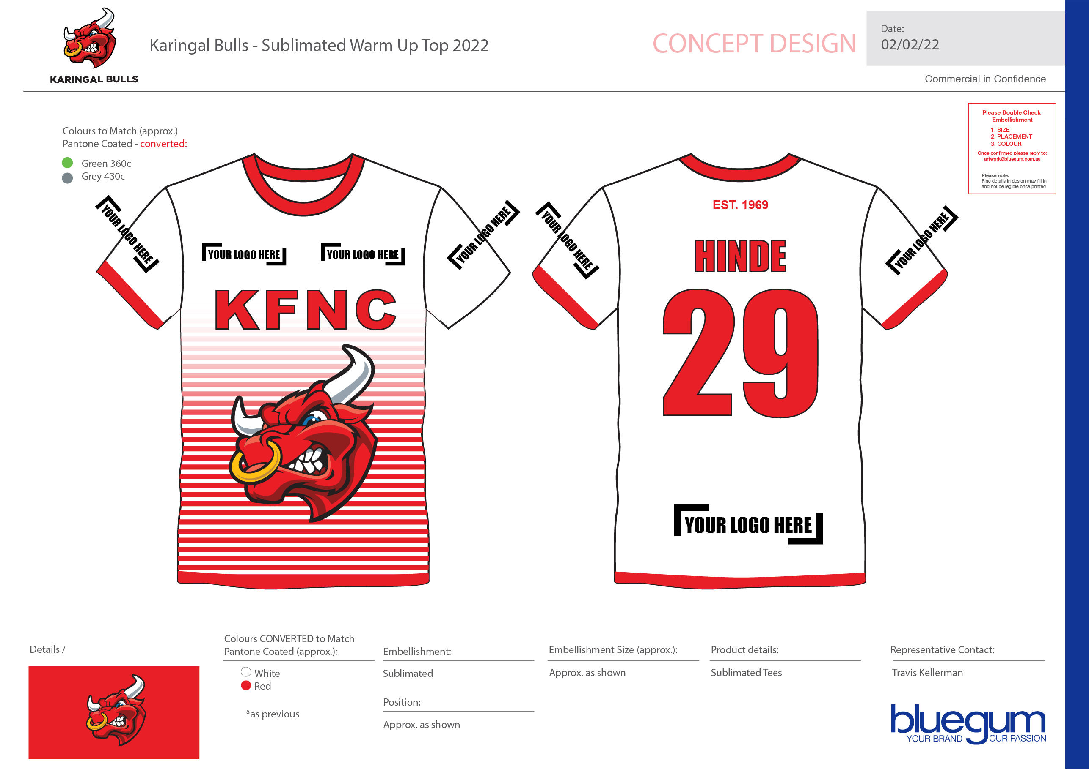
Warm up tops and tee sponsors.
. Get your company name on the front, back or sleeve for all the warmup tops and tee’s.
. Front sponsor is $500
. Sleeve sponsor is $400
. Large Back sponsor $1000

Slide 17
Goal Post sponsorship for 2022 season, $5,000
. Get your brand on the Goal post pads, yes, all 8 pads with your company logo for the entire 2022 season, great exposure for your brand.

